Slide 1

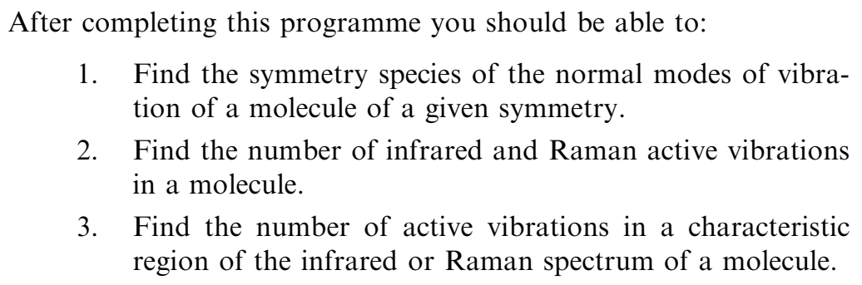
Applications to molecular Vibration

Slide 2
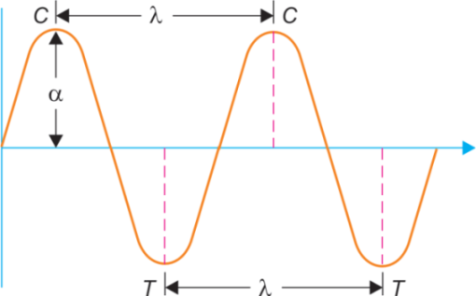
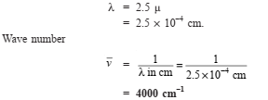
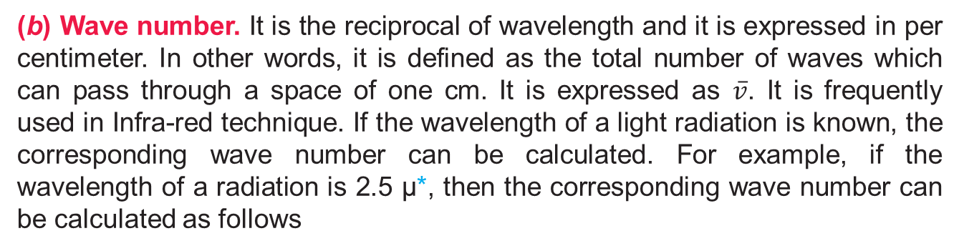
(a) Wavelength. It is the distance between the two adjacent crests (C—C) or troughs(T—T) in a particular wave. It is denoted by the letter λ (lambda). It can be expressed in Angstrom units or in millimicrons (mμ).
1 Å = 10^{–8} cm = 10^{–10} m; 1 mμ = 10^{–7} cm; 1 μ = 10^{–4} cm.
(b) Wave number. It is the reciprocal of wavelength and it is expressed in per centimeter. In other words, it is defined as the total number of waves which can pass through a space of one cm. It is expressed as $\overline{v}$. It is frequently used in Infra-red technique. If the wavelength of a light radiation is known, the corresponding wave number can be calculated. For example, if the wavelength of a radiation is 2.5 μ*, then the corresponding wave number can be calculated as follows

Slide 3

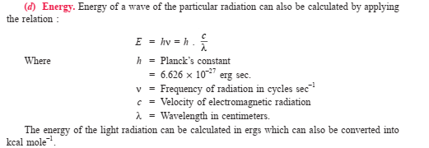

E = hc$\overline{v}$

Slide 4
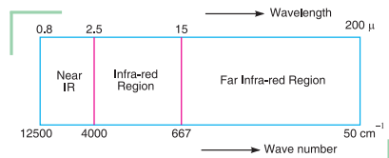
Infra-red Radiation Region
The ordinary infra-red region extends from 2.5 μ to 15 μ . The region from 0.8 μ to 2.5 μ is called Near infra-red and that from 15 μ to 200 μ is called Far IR Region.

Slide 5
Principle of Infra-red Spectroscopy
The absorption of Infra-red radiations causes an excitation of molecule from a lower to the higher vibrational level.
We know that each vibrational level is associated with a number of closely spaced rotational levels. Clearly, the Infra-red spectra is considered as vibrational-rotational spectra.
All the bonds in a molecule are not capable of absorbing infra-red energy but only those bonds which are accompanied by a change in dipole moment will absorb in the infra-red region.
Such vibrational transitions which are accompanied by a change in the dipole-moment of the molecule are called infra-red active transitions.
Thus, these are responsible for absorption of energy in the Infra-red region. On the other hand, the vibrational transitions which are not accompanied by a change in dipole-moment of the molecule are not directly observed and these are Infra-red inactive.
For example, vibrational transitions of C = O, N—H, O—H etc. bands are accompanied by a change in dipole-moment and thus, absorb strongly in the Infra-red region.
But transitions in Carbon-Carbon bonds in symmetrical alkenes and alkynes are not accompanied by the change in dipole-moment and hence do not absorb in the infra-red region. It is important to note that since the absorption in infra-red region is quantized, a molecule of the organic compound will show a number of peaks in the infra-red region.

Slide 6
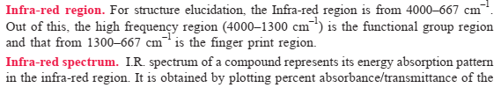
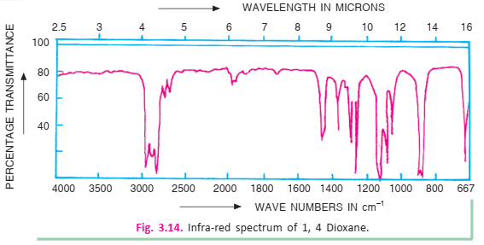

Slide 7
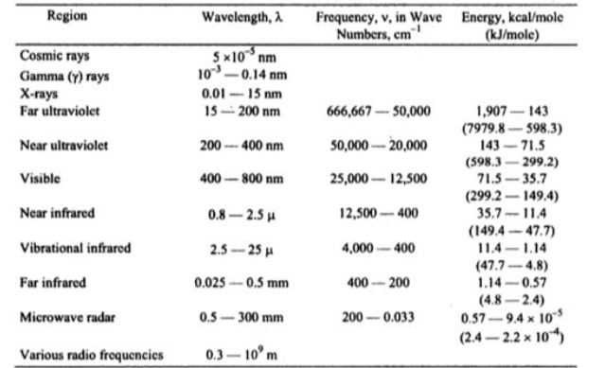
Region of Electromagnetic Spectra

Slide 8
Translational Mode : Motion of the entire molecule from one place to another in space.
Involves movement along the x, y, and z axes.
All molecules (solid, liquid, or gas) can exhibit translation, especially in gases.
There are always 3 translational degrees of freedom for any molecule.
Energy Range: Lowest compared to other modes.
Example: A molecule moving in a straight line across a container.
Rotational Mode: Motion of the molecule around its center of mass.
Depends on molecular geometry:
  Linear molecules: 2 rotational degrees of freedom.
  Nonlinear molecules: 3 rotational degrees of freedom.
Not all molecules show rotational motion in the solid phase (restricted), but it’s active in gases and liquids.
Energy Range: Higher than translational, but lower than vibrational (microwave region)
Example: O₂ molecule spinning around its center.
Vibrational Mode: Periodic motion of atoms within a molecule relative to each other (bond stretching and bending).
Number of vibrational modes (fundamental) = 3N – 6 for nonlinear molecules
  = 3N – 5 for linear molecules (where N = number of atoms)
Energy Range: Highest among the three. (infrared region)
Example: The stretching of the H–O–H bond in a water molecule.

Slide 9
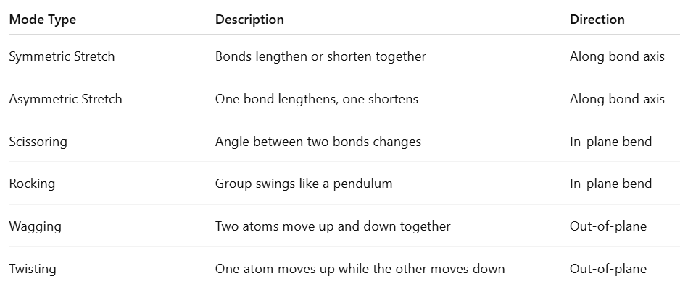
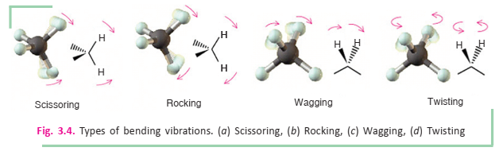
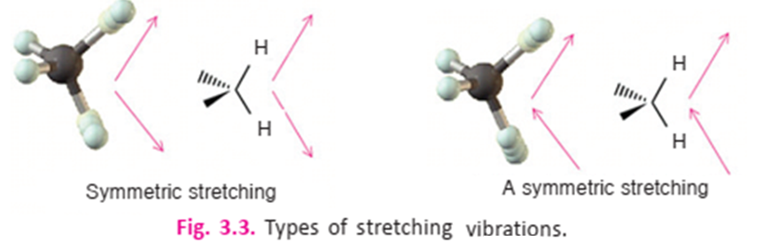

Slide 10
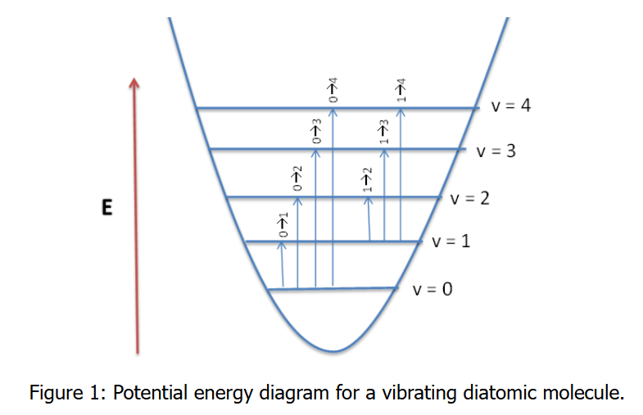
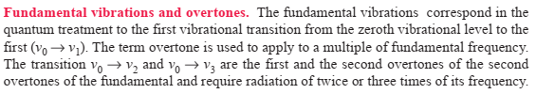
Fundamental Vibrations, Overtones, Combination band, Couple vibration and Fermi resonance
Fundamental vibrational frequencies of a molecule corresponds to transition from v = 0 to v = 1. For a non-linear molecule there will by 3N-6 (where N is the number of atoms) number vibrations. The same holds true for linear molecules, however the equations 3N-5 is used, because a linear molecule has one less rotational degrees of freedom.
Combination bands and overtones generally have lower intensities than the fundamentals

Slide 11
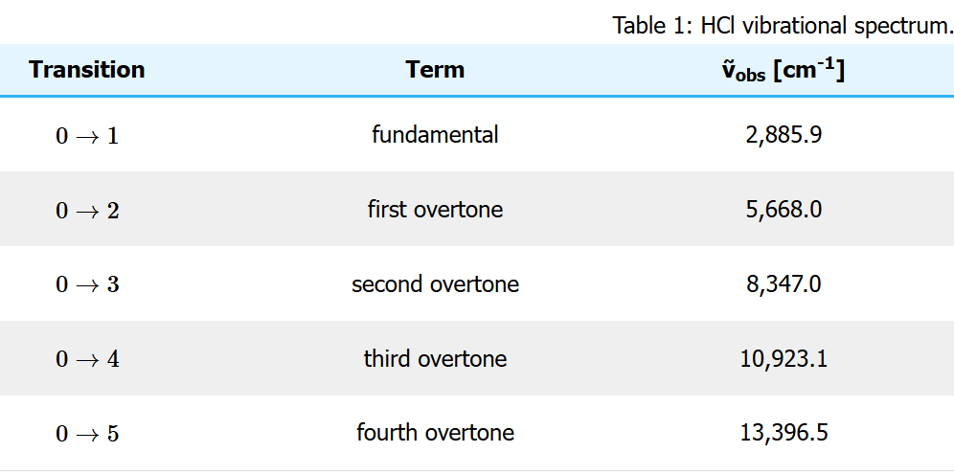
Fundamental Vibrations, Overtones, Combination band, Couple vibration and Fermi resonance
For HCl molecule

Slide 12
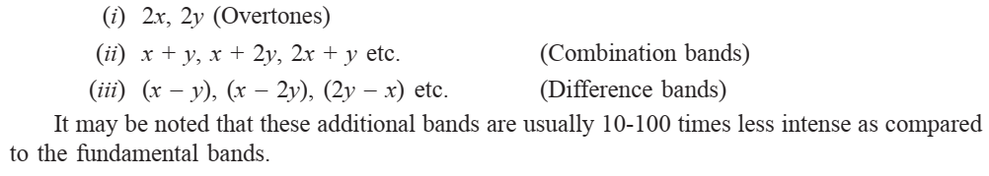
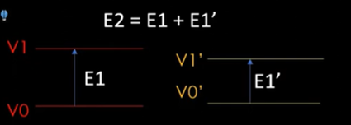
Fundamental Vibrations, Overtones, Combination band, Couple vibration and Fermi resonance
If there are two fundamental bands at x and y, then the additional bands can be expected at:
Combination bands: Coupling of two fundamental vibrations; E2 = E1 + E1’
1400 cm⁻¹ Fundamental Frequency (ν₀→ ν₁)
750 cm⁻¹ Fundamental Frequency (ν_{0’}→ ν_{1’})
2150 cm⁻¹ Combination bands E2 = E1 + E1’

Slide 13
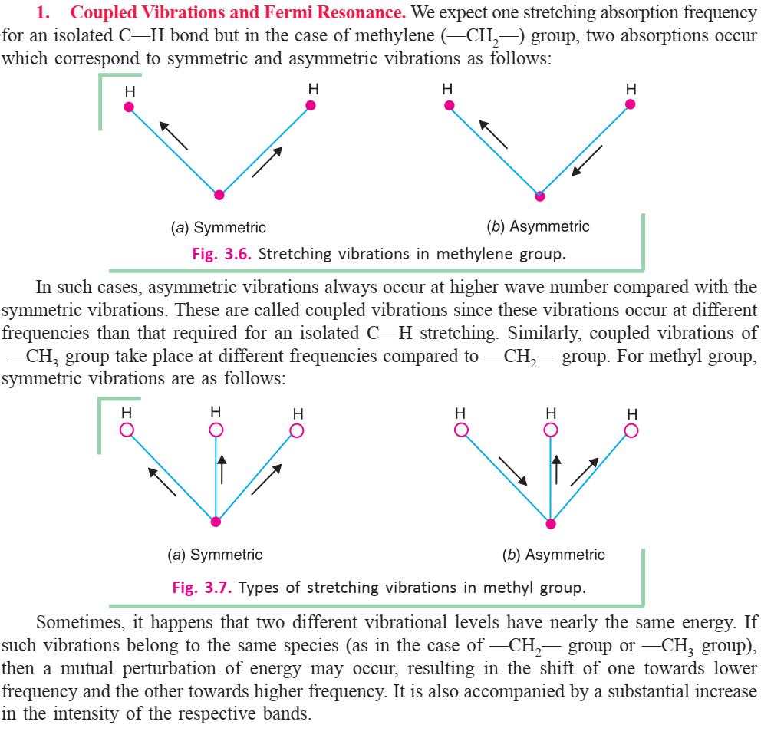

Slide 14
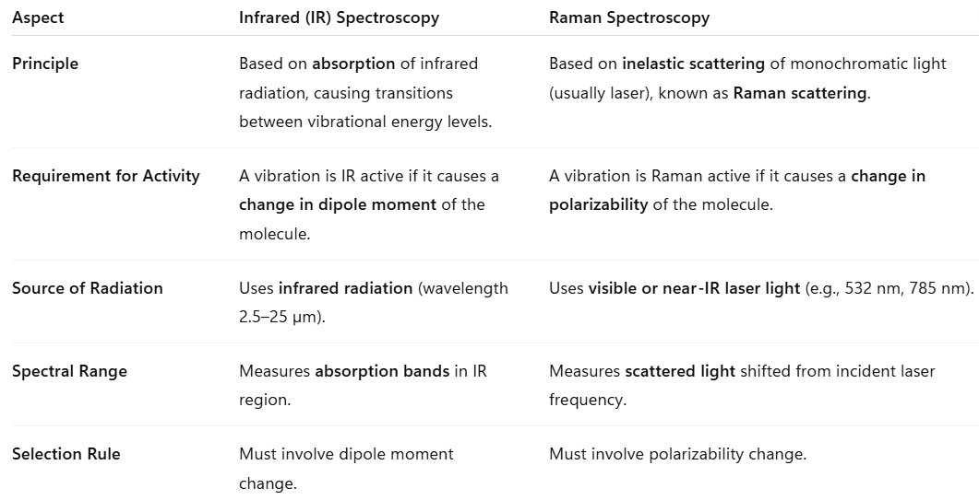
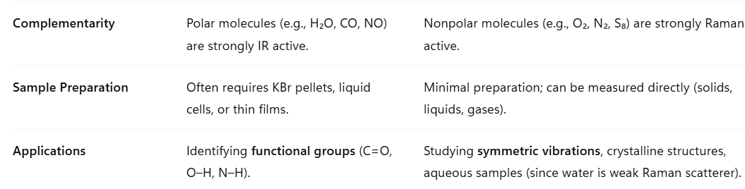

Slide 15
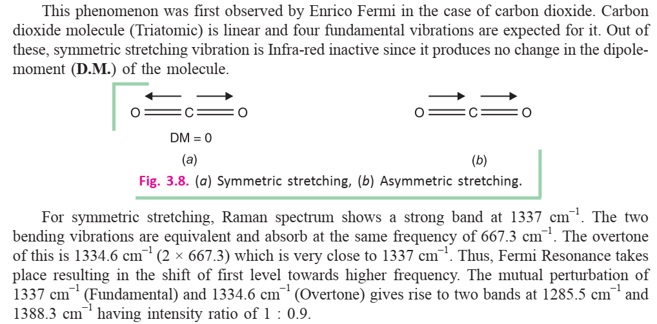

Slide 16
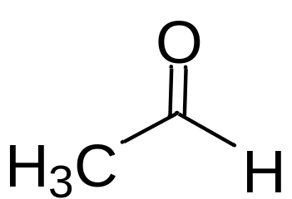
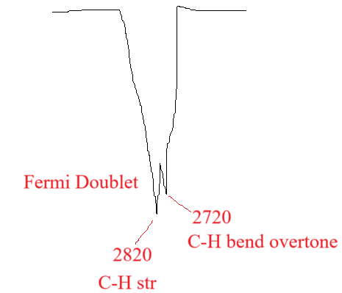
Fermi Resonance
C-H stretching = 2800 cm⁻¹ (Fundamental)
C-H bending = 1390 cm⁻¹ (Fundamental) and 2780 cm⁻¹ (overtone)
Fermi Resonance at 2820 and 2720 cm^{-1 .}
Fermi resonance results in the splitting of two vibrational bands that have nearly the same energy and symmetry in both IR and Raman spectroscopies. The two bands are usually a fundamental vibration and either an overtone or combination band. The wave functions for the two resonant vibrations mix according to the harmonic oscillator approximation, and the result is a shift in frequency and a change in intensity in the spectrum. As a result, two strong bands are observed in the spectrum, instead of the expected strong and weak bands. It is not possible to determine the contribution from each vibration because of the resulting mixed wave function.

Slide 17
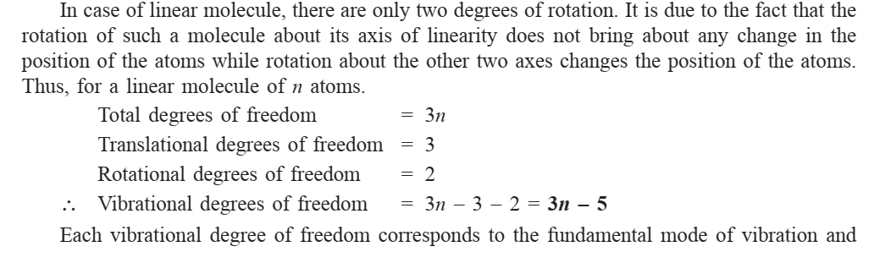
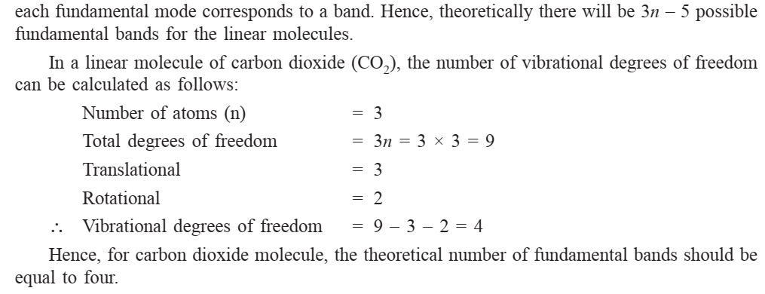
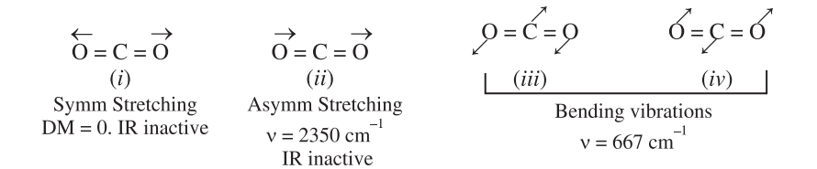

Slide 18
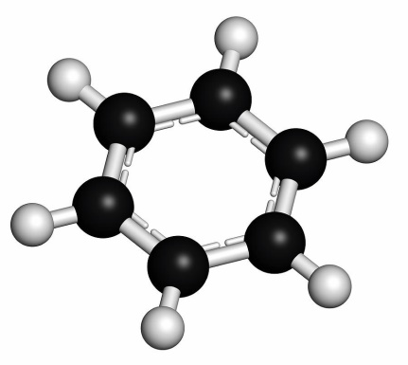
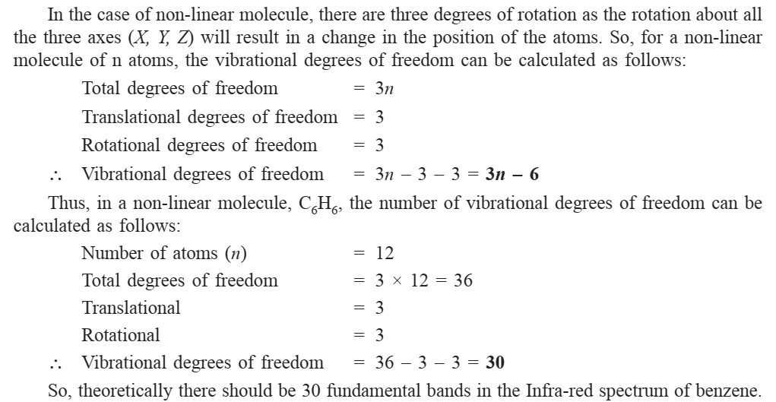

Slide 19
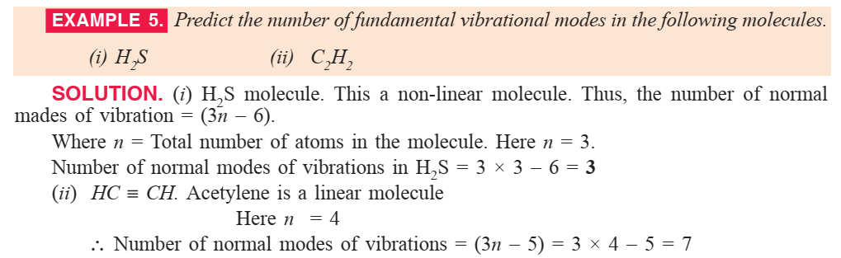

Slide 20
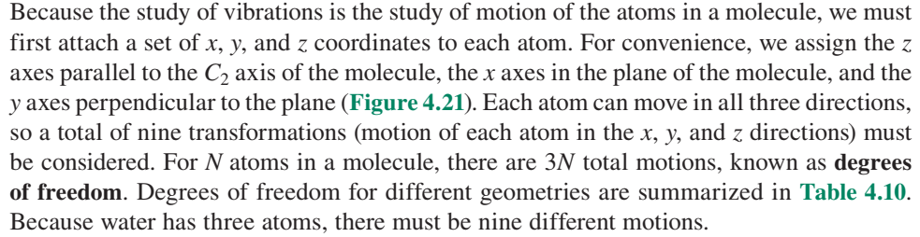
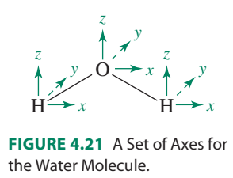
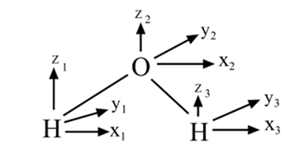
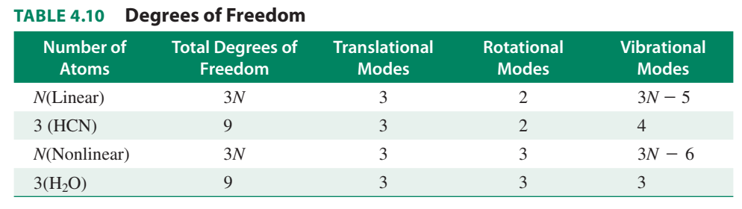
Water (C_{2v} Symmetry)

Slide 21
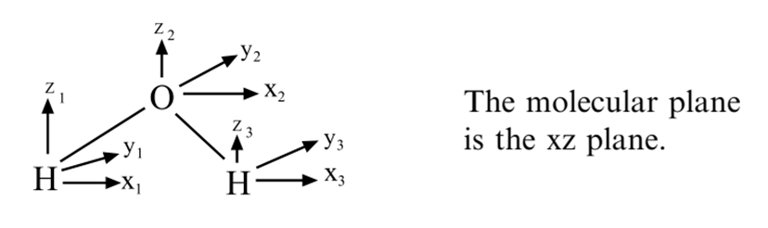
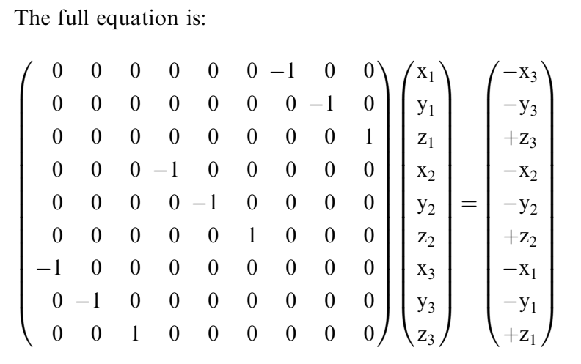
Matrix
The full 9 x 9 matrix for C₂ operation is shown below
Character = -1

Slide 22
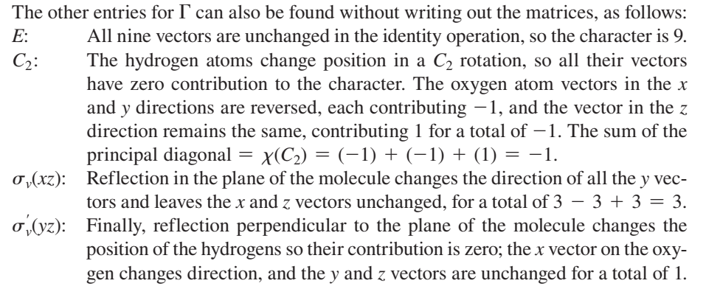
The sum of the principal diagonal = χ(σ_{v}(yz)) = (-1) + (1) + (1) = 1.

Slide 23
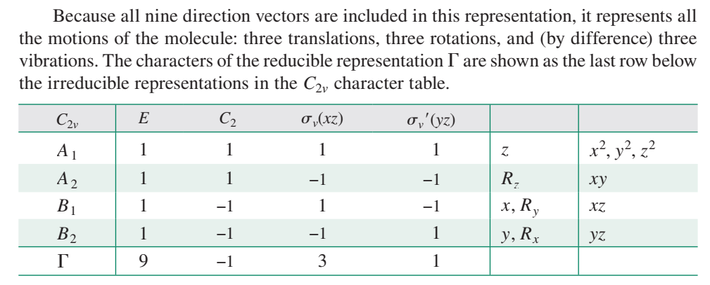
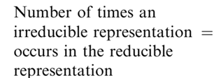
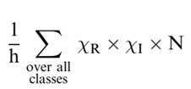

Slide 24
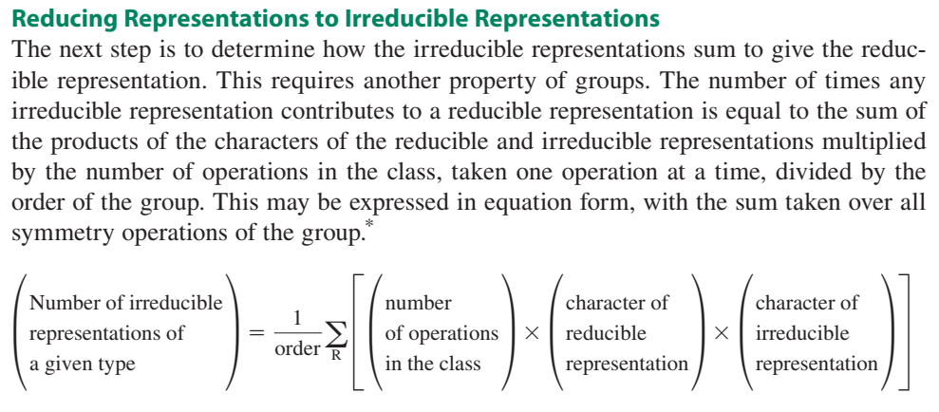
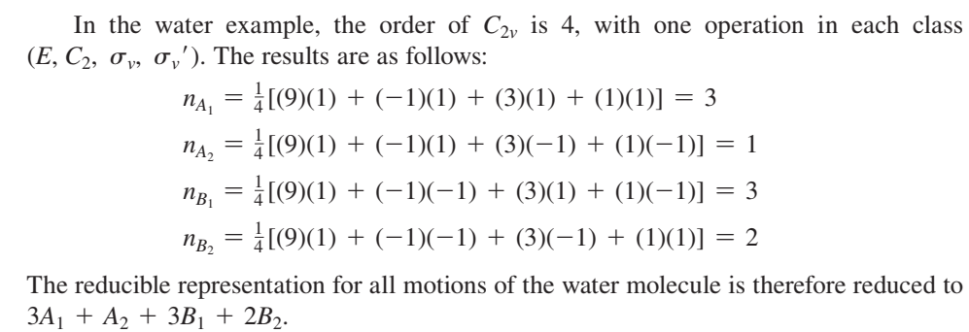
Reducing Representations to Irreducible Representation

Slide 25
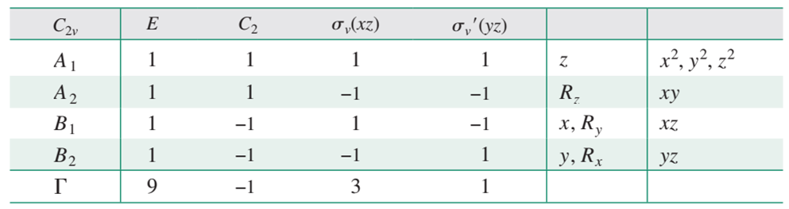
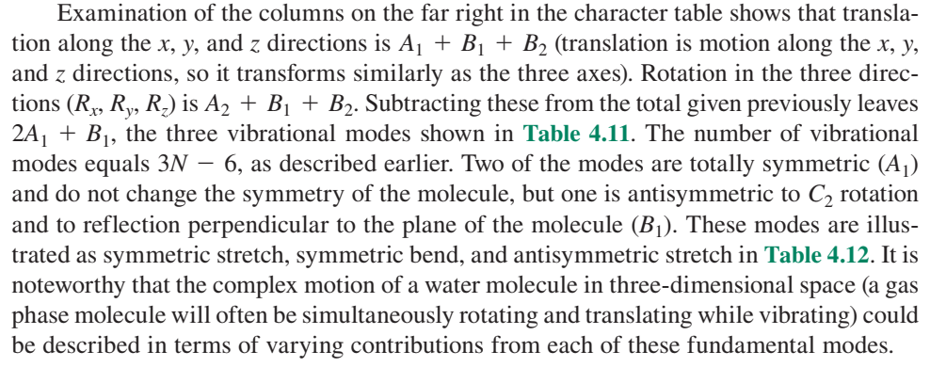

Slide 26
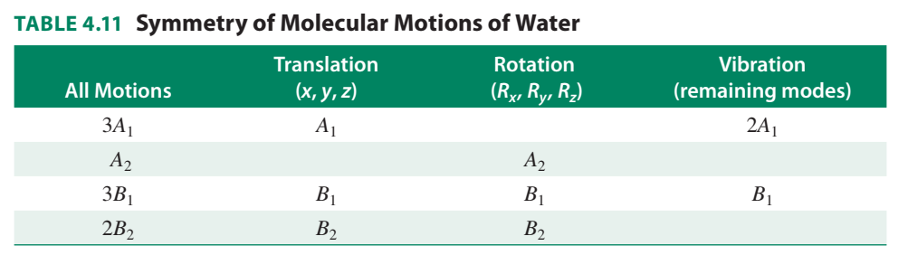

Slide 27
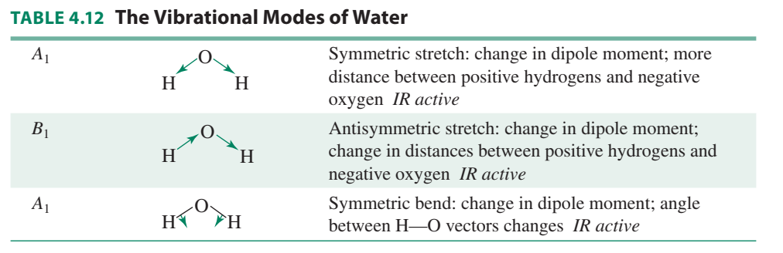

Slide 28
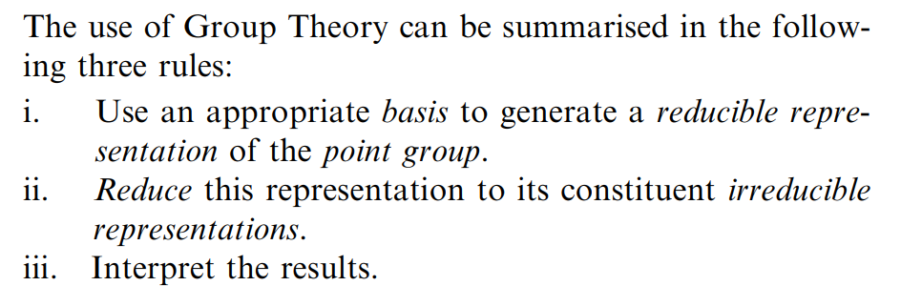
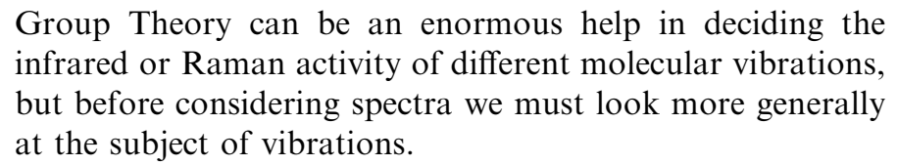
Applications to molecular Vibration

Slide 29
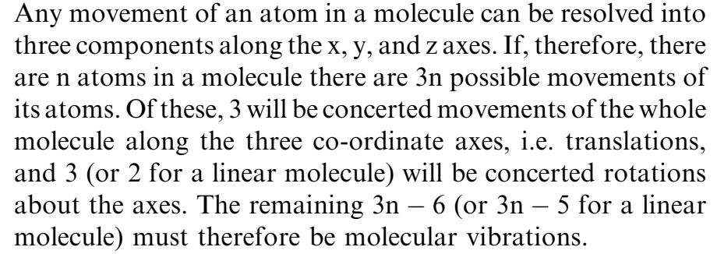
Applications to molecular Vibration

Slide 30
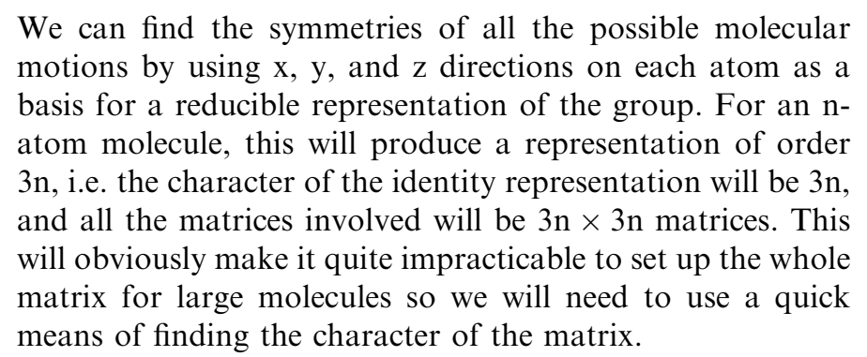
Applications to molecular Vibration

Slide 31


Applications to molecular Vibration

Slide 32
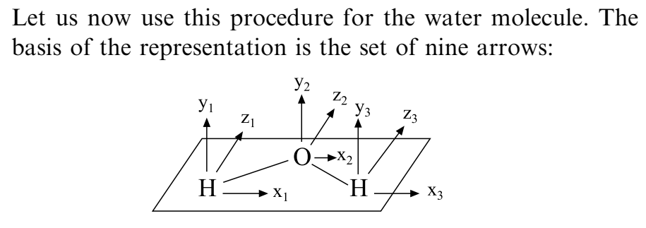

Applications to molecular Vibration

Slide 33


Applications to molecular Vibration

Slide 34




Applications to molecular Vibration

Slide 35


Applications to molecular Vibration

Slide 36


Applications to molecular Vibration

Slide 37

Applications to molecular Vibration

Slide 38


Applications to molecular Vibration

Slide 39

Applications to molecular Vibration

Slide 40


Applications to molecular Vibration

Slide 41


Applications to molecular Vibration

Slide 42


Applications to molecular Vibration

Slide 43

Applications to molecular Vibration

Slide 44

Applications to molecular Vibration

Slide 45


Applications to molecular Vibration

Slide 46


Applications to molecular Vibration

Slide 47



Applications to molecular Vibration
Which of the vibrations of H₂O are infrared and Raman active?

Slide 48


Applications to molecular Vibration
IR active

Slide 49

Applications to molecular Vibration
IR active

Slide 50

Applications to molecular Vibration

Slide 51

Applications to molecular Vibration

Slide 52



Applications to molecular Vibration

Slide 53


Applications to molecular Vibration

Slide 54

Applications to molecular Vibration

Slide 55



Applications to molecular Vibration
Point group: C_{3v}
Symmetry element: E 2C₃ 3σ_{v}

Slide 56


Applications to molecular Vibration
Point group: C_{3v}
Symmetry element: E 2C₃ 3σ_{v}

Slide 57

Applications to molecular Vibration

Slide 58





Applications to molecular Vibration

Slide 59


Applications to molecular Vibration

Slide 60



Applications to molecular Vibration

Slide 61

Applications to molecular Vibration

Slide 62



Applications to molecular Vibration

Slide 63

Applications to molecular Vibration

Slide 64


Applications to molecular Vibration

Slide 65

Applications to molecular Vibration

Slide 66

Applications to molecular Vibration
The character Table for NH₃ molecule is given below

Slide 67

Applications to molecular Vibration

Slide 68





Applications to molecular Vibration
Point Group: T_{d}
Symmetry element: E, C₃, C₂, S₄, σ_{d}

Slide 69

Applications to molecular Vibration
Point Group: T_{d}
Symmetry element: E, 4C₃, 3C₂, 3S₄, 6σ_{d}
Symmetry element in multiplication Table: E, 8C₃, 3C₂, 6S₄, 6σ_{d}

Slide 70

Applications to molecular Vibration
T_{d}
E, C₃, C₂, S₄, σ_{d}

Slide 71




Applications to molecular Vibration
Character of reducible representation = No. of atoms unshifted X Factor for the operation

Slide 72

Applications to molecular Vibration

Slide 73

Applications to molecular Vibration
Character of reducible representation = 1 X ─ 1 = ─ 1
For C₃ operation the reducible representation = ─ 1

Slide 74

Applications to molecular Vibration

Slide 75

Applications to molecular Vibration

Slide 76

Applications to molecular Vibration

Slide 77

Applications to molecular Vibration

Slide 78

Applications to molecular Vibration

Slide 79


Applications to molecular Vibration

Slide 80


Applications to molecular Vibration

Slide 81


Applications to molecular Vibration
A₁ + E + 0 + 2T₂

Slide 82



Applications to molecular Vibration

Slide 83

Applications to molecular Vibration

Slide 84


Applications to molecular Vibration

Slide 85


Applications to molecular Vibration

Slide 86




Applications to molecular Vibration

Slide 87





Applications to molecular Vibration

Slide 88



Applications to molecular Vibration

Slide 89



Applications to molecular Vibration

Slide 90



Applications to molecular Vibration

Slide 91
Applications to molecular Vibration

Slide 92
Applications to molecular Vibration

Slide 93
Applications to molecular Vibration

Slide 94
Applications to molecular Vibration

Slide 95
Applications to molecular Vibration

Slide 96
Applications to molecular Vibration

Slide 97
Applications to molecular Vibration

Slide 98
Applications to molecular Vibration

Slide 99
Applications to molecular Vibration

Slide 100
Applications to molecular Vibration

Slide 101
Applications to molecular Vibration

